Slide 1
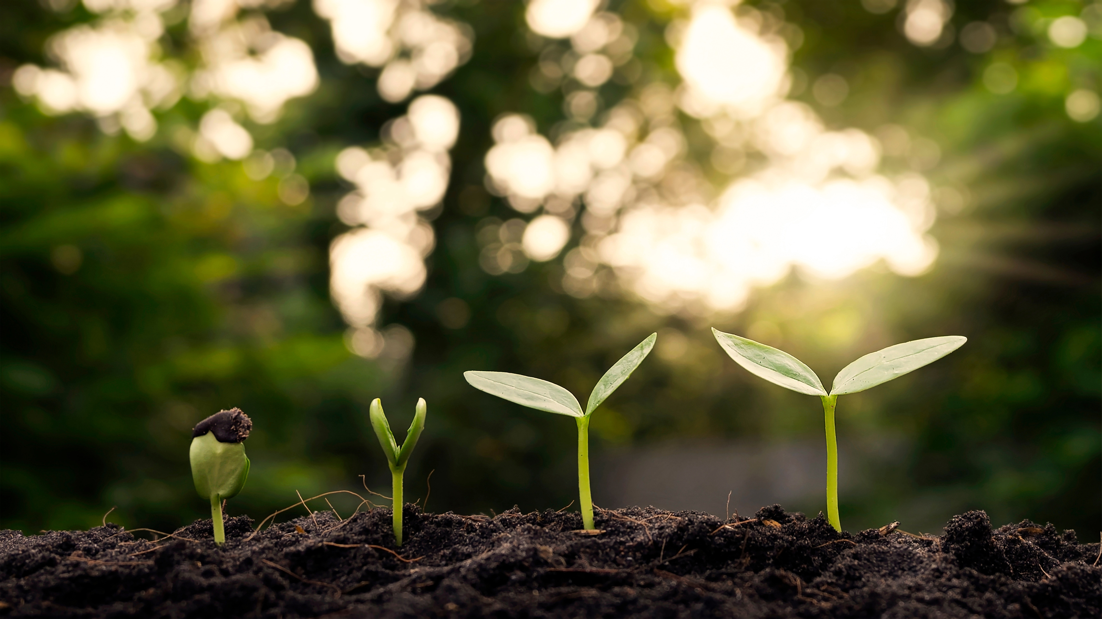
GREENIFY
SustainableLivingApp

Slide 2



PROBLEM STATEMENT
Develop a sustainable living app in Flutter that provides users with eco-friendly tips, local recycling information, carbon footprint calculators, and sustainable product recommendations.
Integrate location services to suggest nearby recycling centers or partner with sustainability organizations (if applicable).
Utilize state management to offer personalized eco friendly challenges and reward users for their efforts.

Slide 3
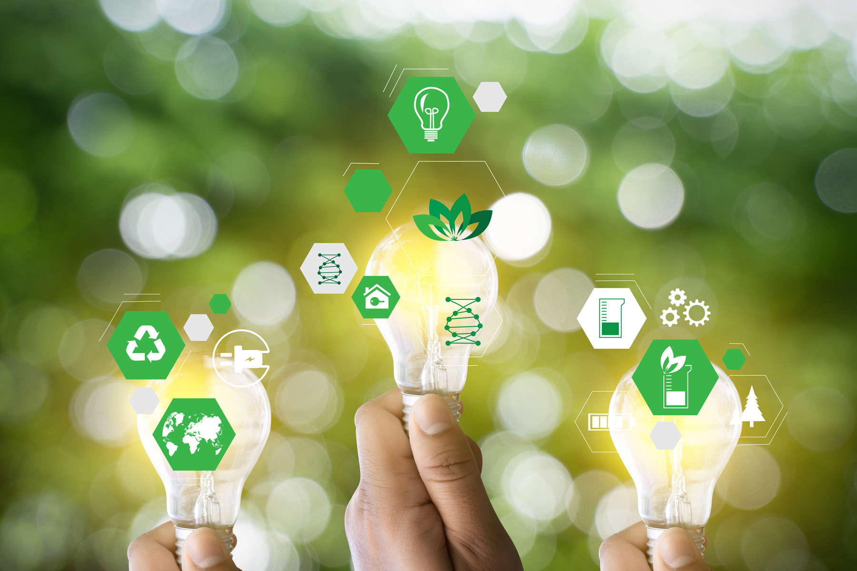
INTRODUCTION
Greenify is an innovative mobile application designed to promote sustainable living by providing users with essential eco-friendly resources and tools. This app aims to help individuals make environmentally conscious decisions in their daily lives. The primary goal of Greenify is to empower users with knowledge and actionable insights on sustainability.

Slide 4




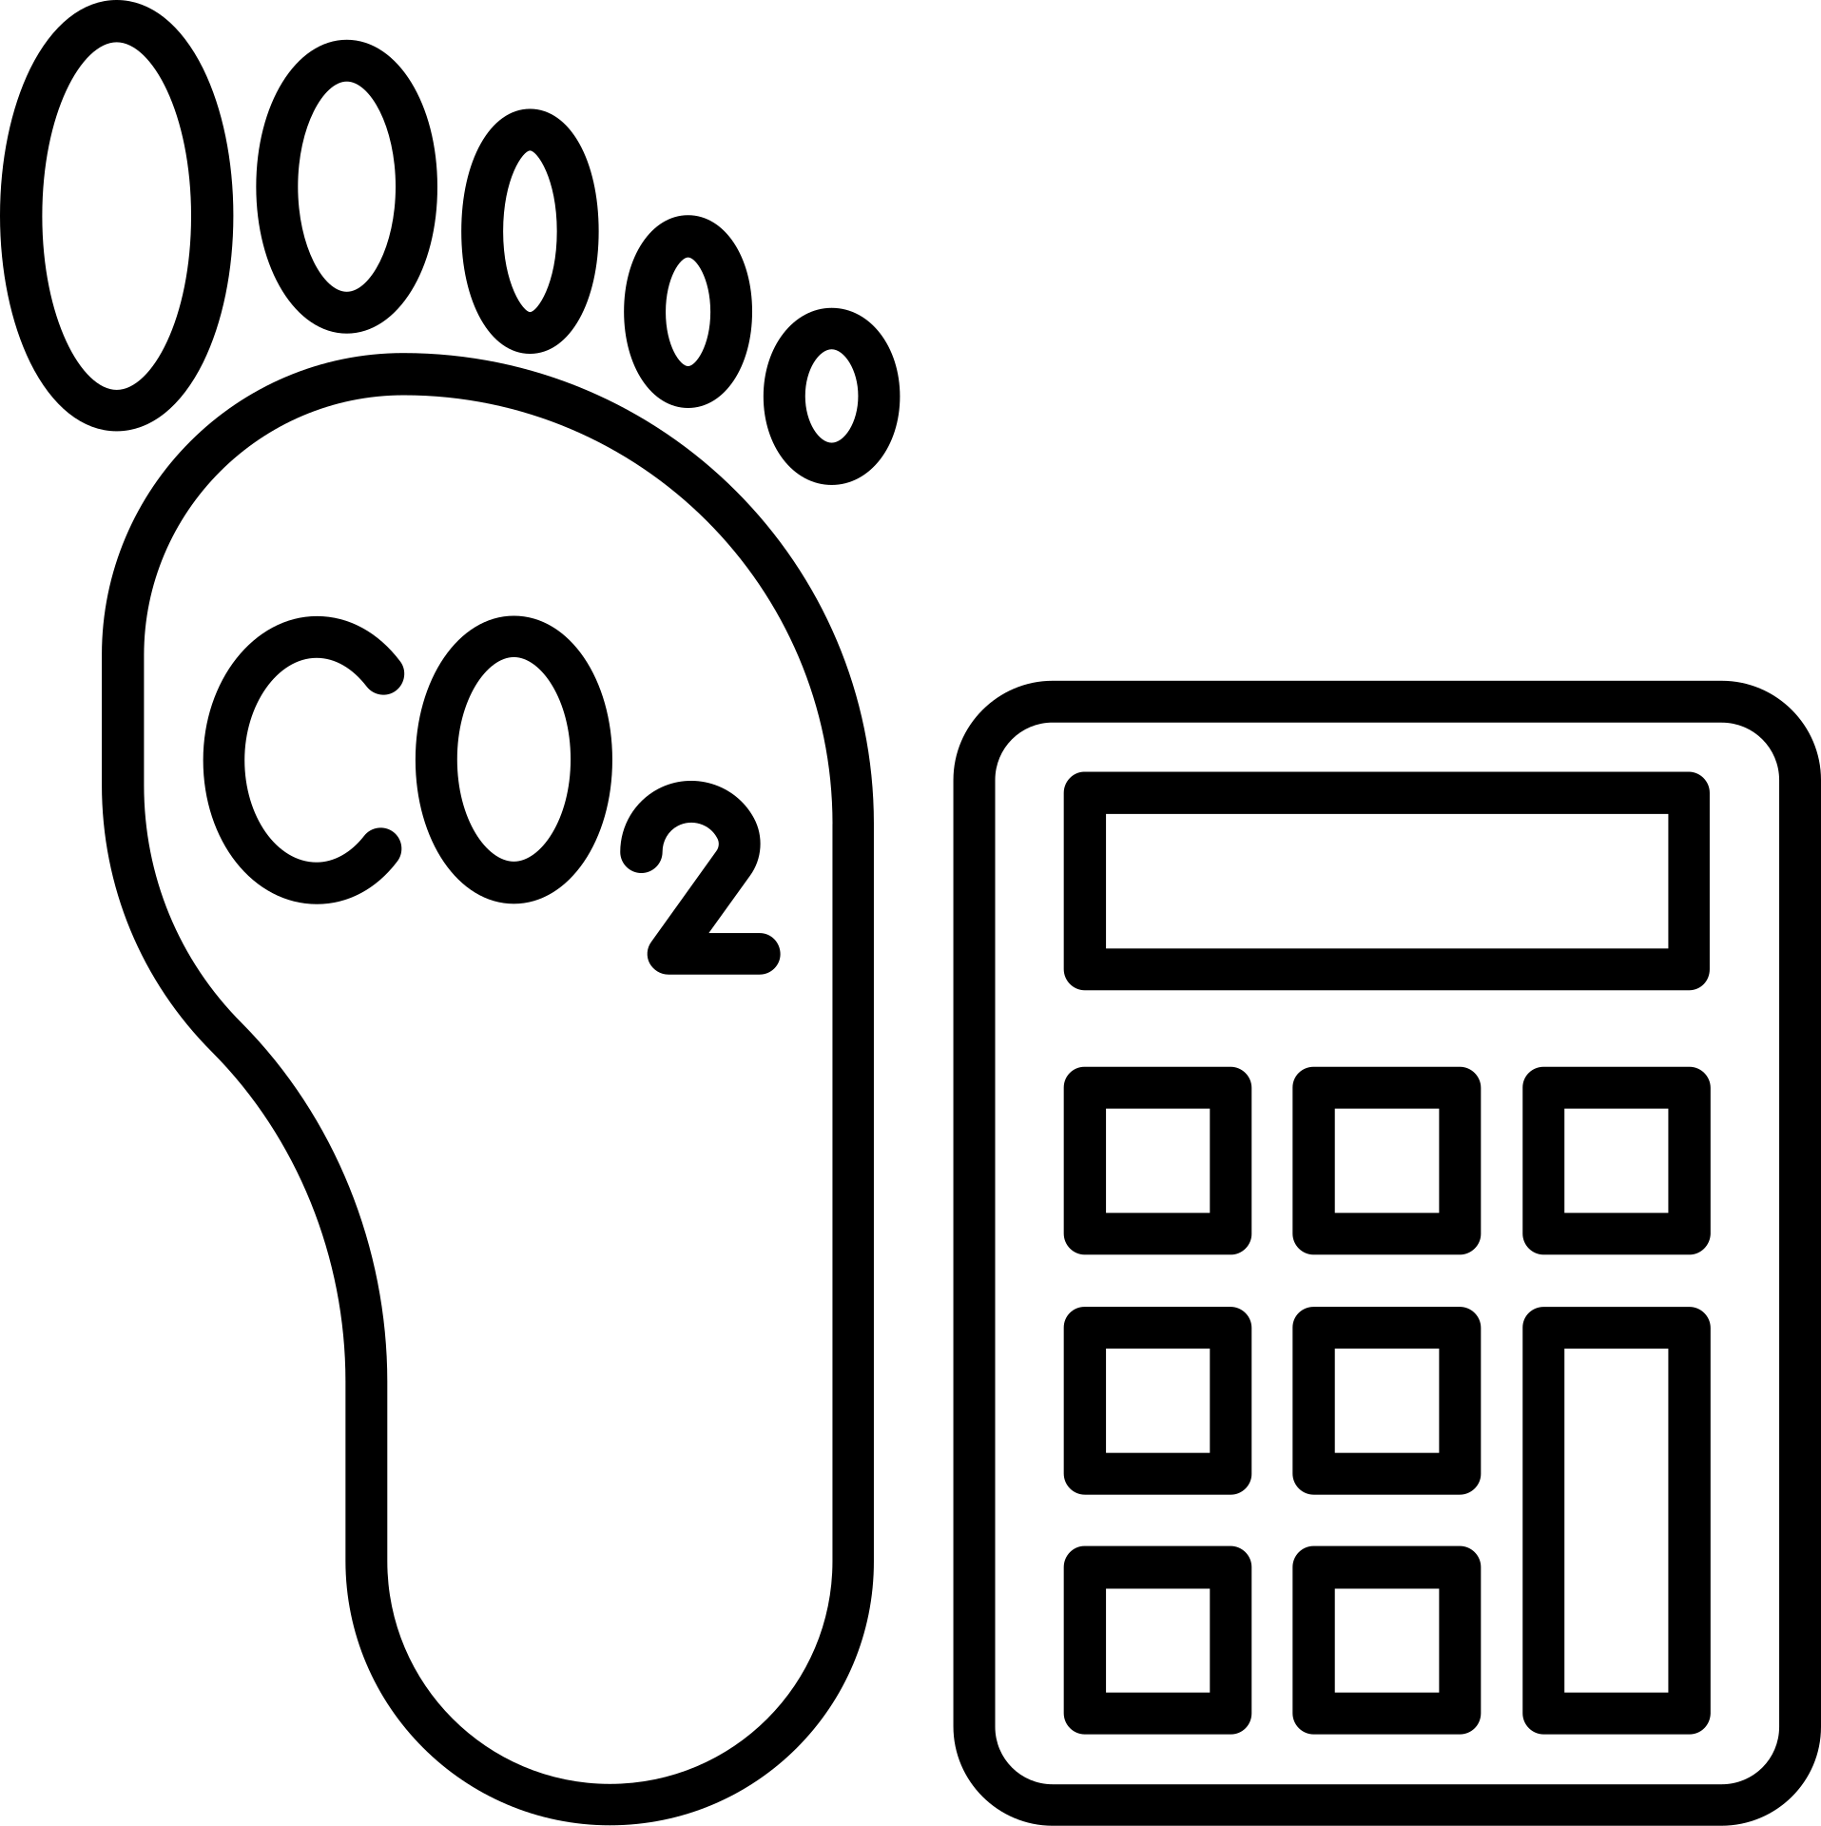

KEY FEATURES
ECO-FRIENDLY TIPS
PERSONALIZED ECO-FRIENDLY CHALLENGES
LOCAL RECYCLING CENTRES
CARBON FOOTPRINT CALCULATOR
SUSTAINABLE PRODUCT RECOMMENDATIONS

Slide 5





APP ARCHITECTURE
FLUTTER AND DART
GEOLOCATION SERVICES USING GEOLOCATOR PACKAGE
STATE MANAGEMENT USING PROVIDER
USER-FRIENDLY INTERFACE
Utilized for cross-platform development to ensure a seamless experience on both Android and iOS devices using Dart programming language.
Focus on a clean, intuitive interface that makes navigation and interaction simple and enjoyable. Emphasizing essential elements.
Employed to manage state efficiently within the app, ensuring smooth and responsive user interactions.
Utilized for obtaining the user’s current location and tracking movement for precise mapping.

Slide 6
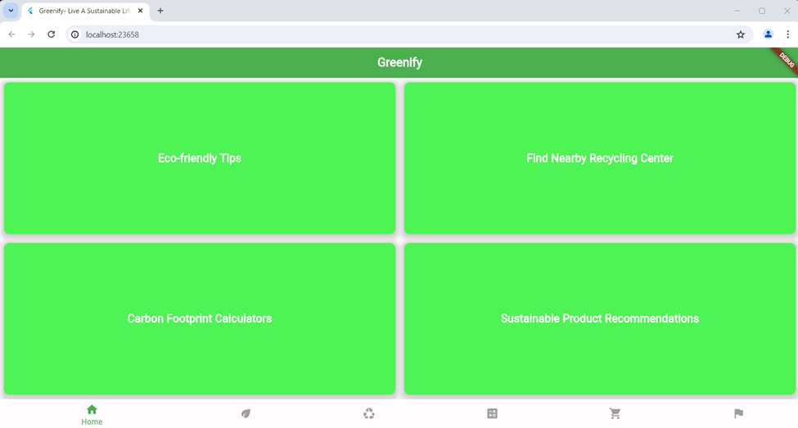
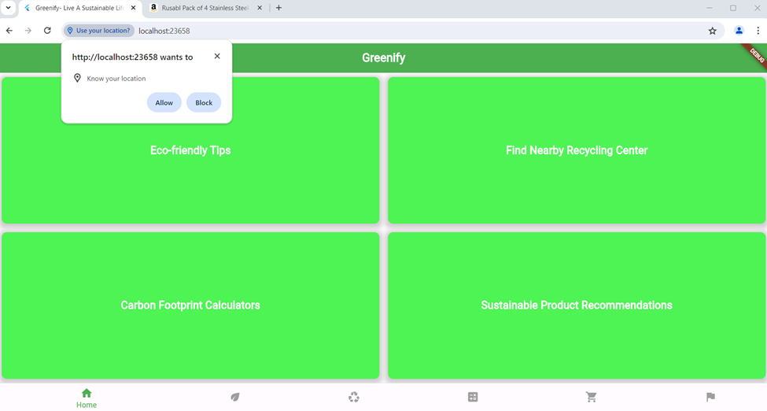
SCREENSHOTS

Slide 7
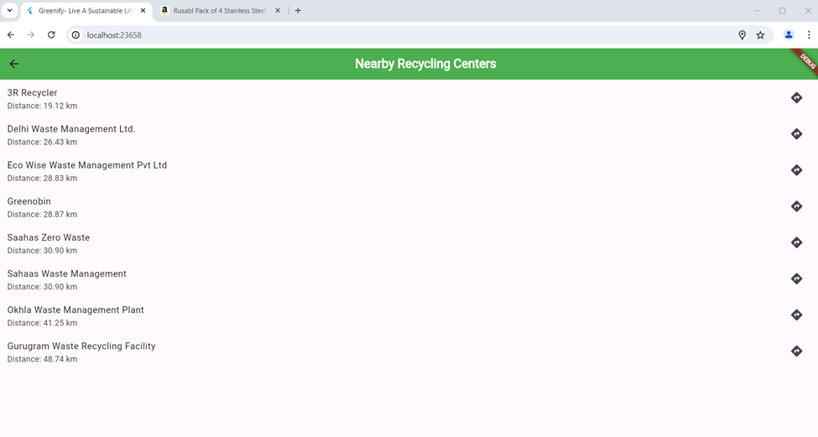
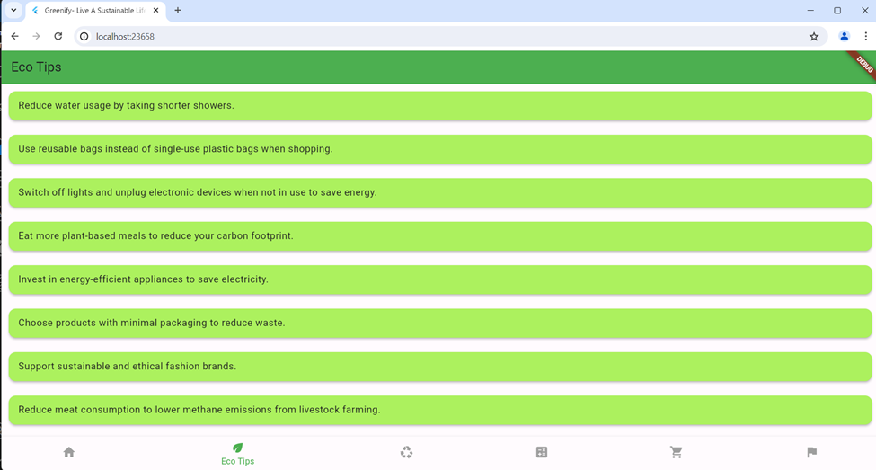
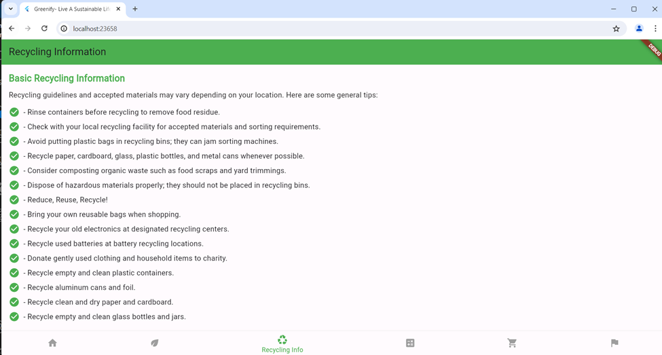
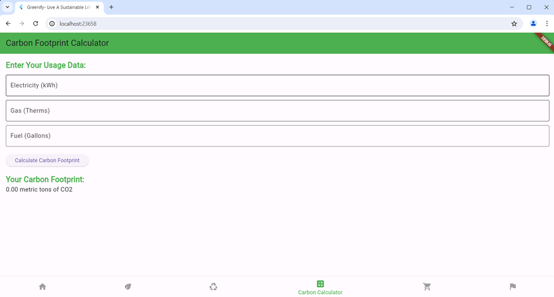

Slide 8
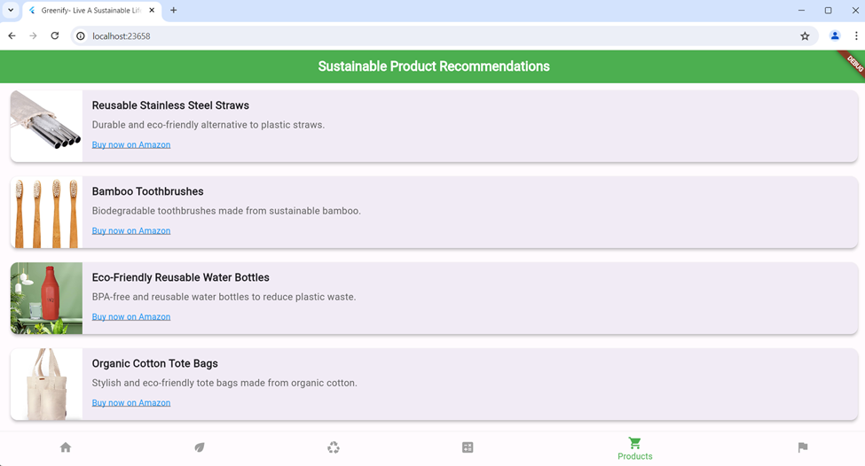

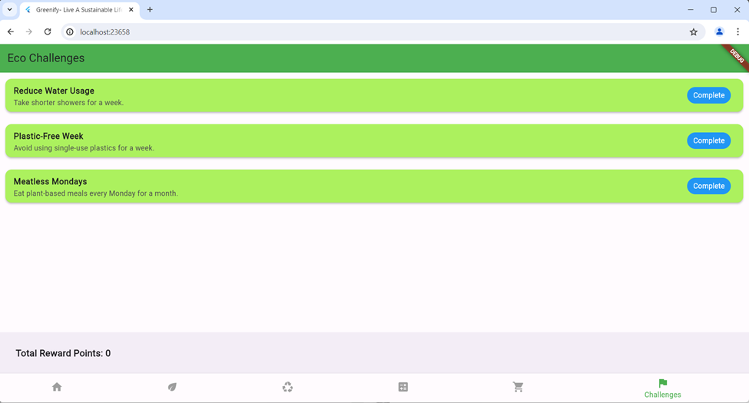
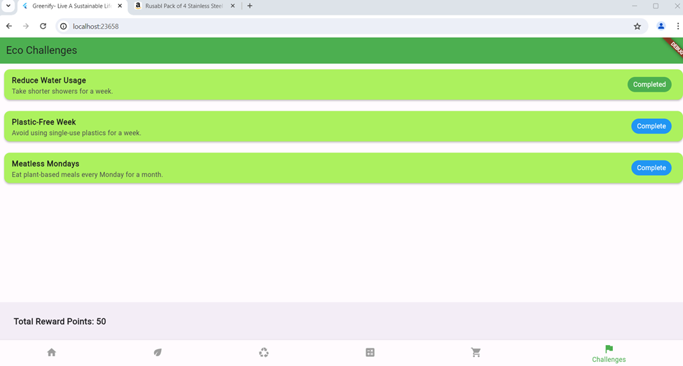

Slide 9




FUTURE ENHANCEMENTS
SOCIAL SHARING
ADVANCED ANALYTICS
ENHANCED PERSONALIZATION
COMMUNITY FEATURES
Enable users to share their eco-friendly achievements and challenges with friends and family via social media platforms.
Implement advanced analytics tools to track user behavior, engagement metrics, and environmental impact over time.
Further personalize user experiences with AI-driven recommendations and challenges tailored to individual interests and habits.
Expand community features with forums, discussion boards, and user-generated content sections.

Slide 10


CONCLUSION
In conclusion, Greenify represents a pioneering effort to harness technology for the betterment of our planet. By providing users with a comprehensive suite of eco-friendly tools and resources, Greenify empowers individuals to make tangible contributions towards a more sustainable future. Together, we can build a future where environmental stewardship is a shared responsibility and a way of life.

Slide 11


THANK YOU
BY:
KAVISH GANDHI (21CSU550)
SRIJAN GUPTA (21CSU566)
PRASHANT YADAV (21CSU572)
PRIYA GARG (21CSU584)
VRINDA (21CSU510)

